Slide 1
CIS 4526 Foundations of Machine Learning
Chapter 19
How to improve Deep Learning Models

Slide 2
Outline
Number one sins
Regularization
Dropout
Data Augmentation
Transfer Learning

Slide 3
Number one sin in model building
What is the most common mistake in model building?

Slide 4
Number one sins in model building
What is the most common mistake in model building?
Overfitting

Slide 5
Number one sins in model building
What is overfitting?

Slide 6
Number one sins in model building
What is overfitting?
Build a model that try to fit the training datasets too much that makes the model fail to generalize to unseen data.
Data always contains noise on top of the real signal. An overfitted model pay too much attention to the noise in the training datasets.

Slide 7

Generalization
❏ An AI problem can be expressed by countless data points;
❏ Training data is merely a pretty small part of the data;
❏ A model that works on the training data might not work on the remaining data
❏ The goal of machine learning is not to fit the training data; instead, we hope the model can handle new data points.
training data

Slide 8
Number one sins in model building
Remember the Bias-Variance Tradeoff slides?

Slide 9
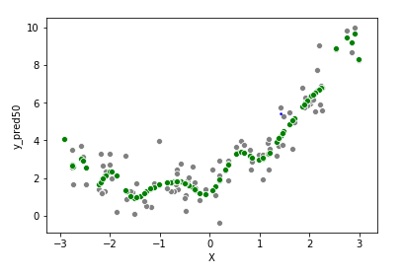
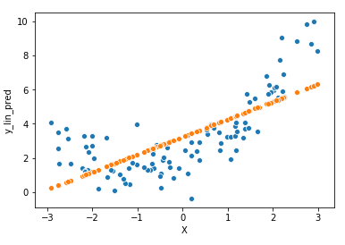
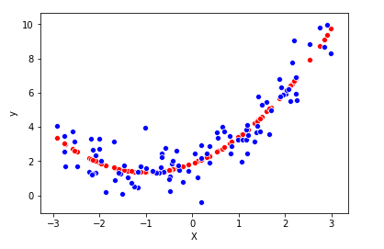
Lessons Learned from Polynomial Regression
Underfit
Good fit
Overfit
A more sophisticated model tends to have smaller errors in the training set, but you run into the risks of overfitting (predictions are all over the place when applied to out-of-sample dataset). We refer to this case as high variance
A too simplistic model will never be able to fit well on both the training set as well as the testing dataset. We refer to this case as high bias.

Slide 10
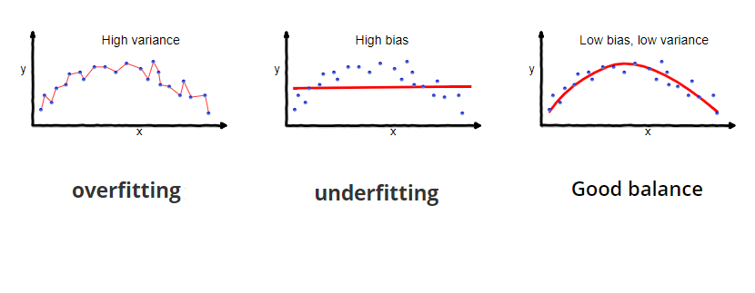
Bias vs Variance Tradeoff

Slide 11
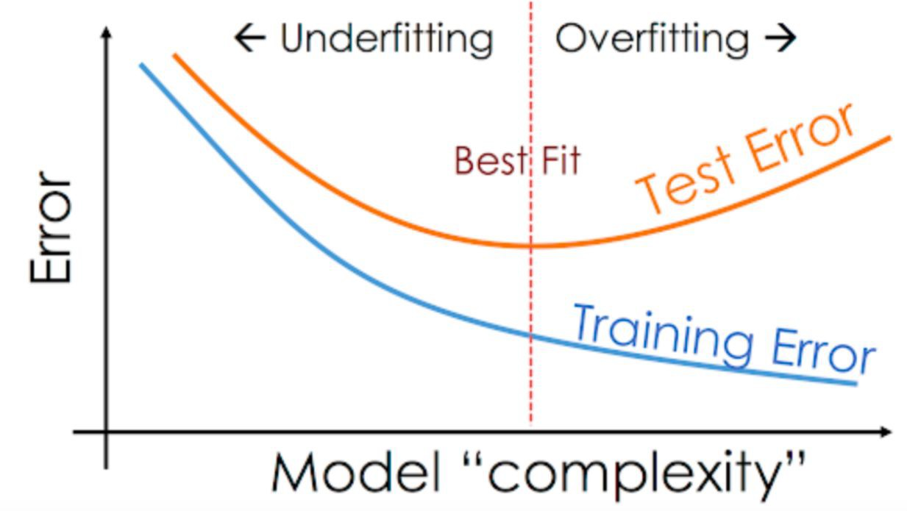
Bias vs Variance Tradeoff

Slide 12
Number one sins in model building
How do we know which cases we are in ?
If we are overfitting, what can we do to avoid it?

Slide 13
Knowing we are underfit or overfit
Learning Curve

Slide 14
Learning Curve
Learning curve are plots that show performance on y-axis versus time or learning experience (i.e., epoch or number of samples in the training dataset) on the x-axis.
Both the learning curves using training dataset will be plotted on the same chart as the curve using validation dataset.
Performance metrics can be based on Loss function or the Accuracy score
The goal of plotting the learning curve is to gauge which cases, overfit, underfit or good fit, the model exhibit

Slide 15
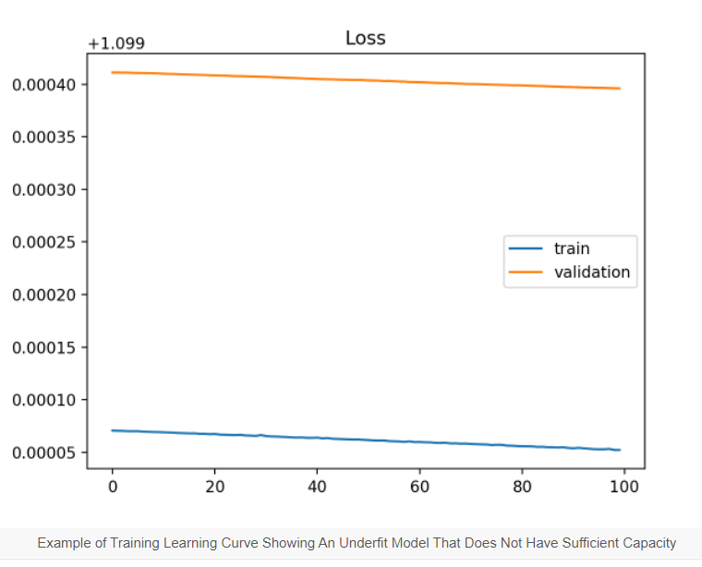
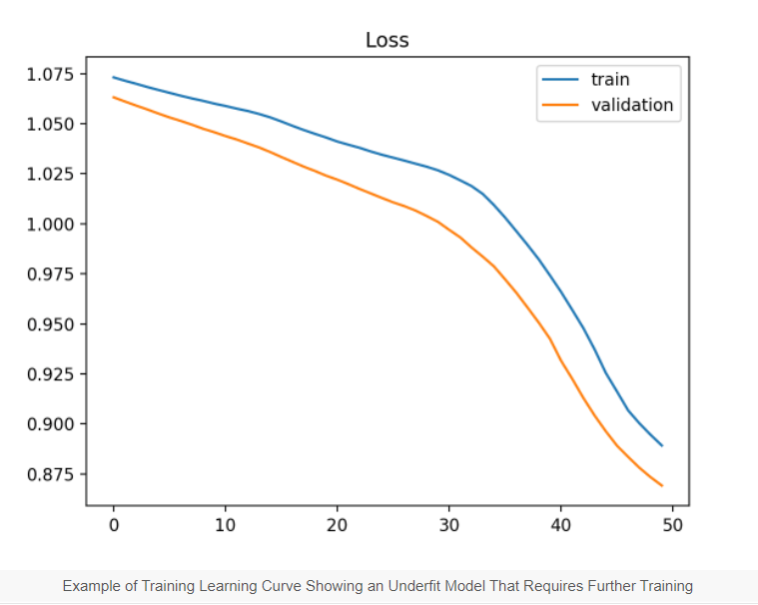
Learning Curve (Underfit case)
A big gap between training and validation curve
There is still big potential for the Loss value to drop further

Slide 16
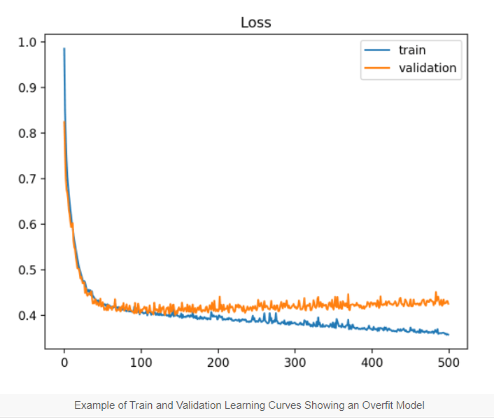
Learning Curve (Overfit case)
The training curve drops further down while the validation reaches a minimum and starts to raise

Slide 17
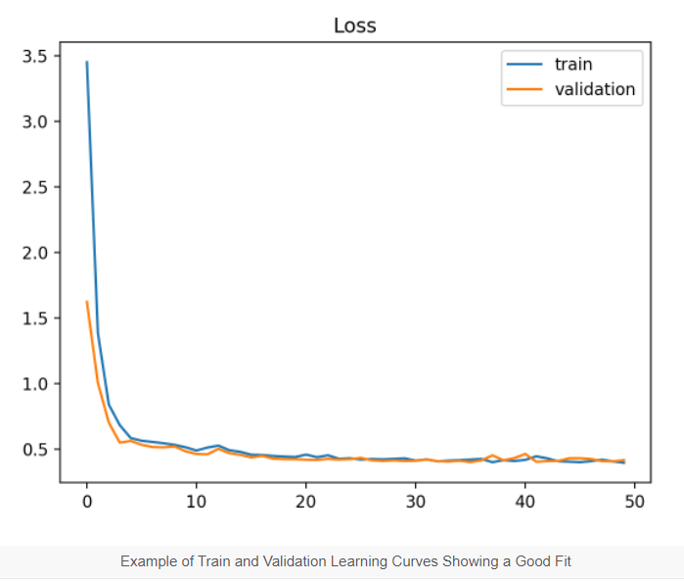
Learning Curve (Goodfit case)
Small gap between the training and validation loss
Both of them plateau

Slide 18
Techniques to reduce overfitting
Regularization
Dropout
Data Augmentation

Slide 19
Regularization
In general: any method to prevent overfitting (or penalize the flexibility of a model)
Specifically: additional terms in the training loss function to penalize weights that are large
Add a term to penalize additional parameters
Add mechanism to avoid the optimization to go with the best fitted parameters

Slide 20
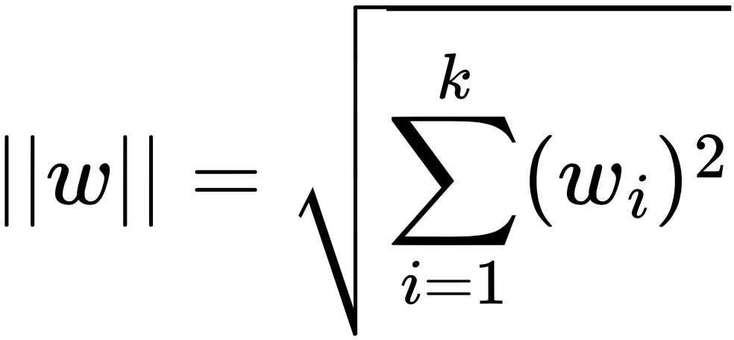
L2 Regularization
Given weights w={w₁, w₂, …, w_{k}}, we can define “how large are weights” as:
❏ This is called the L2 norm of w
❏ A norm is a measure of a vector’s length
❏ Also called the Euclidean norm

Slide 21
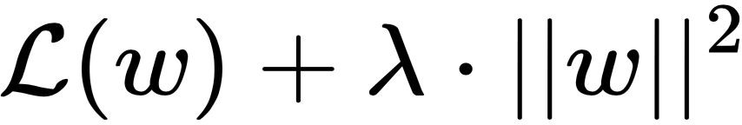
L2 Regularization
❏ L2 is the most common type of regularization
❏ Logistic regression implementations usually use L2 regularization by default
❏ L2 regularization can be added to any gradient descent algorithms

Slide 22
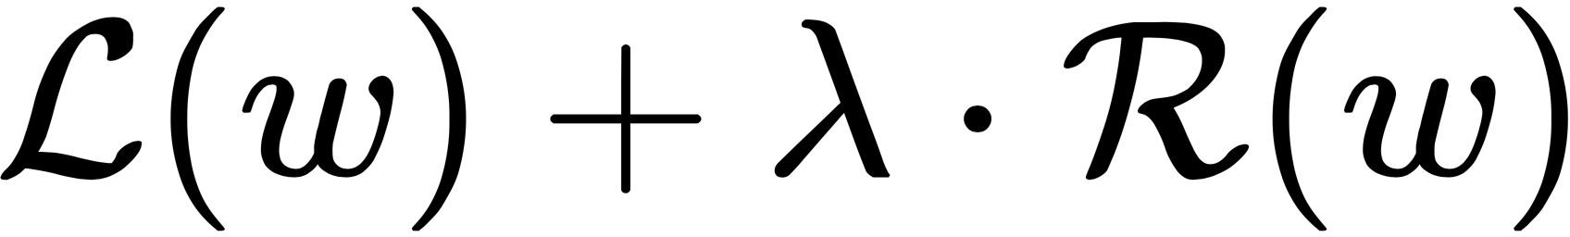
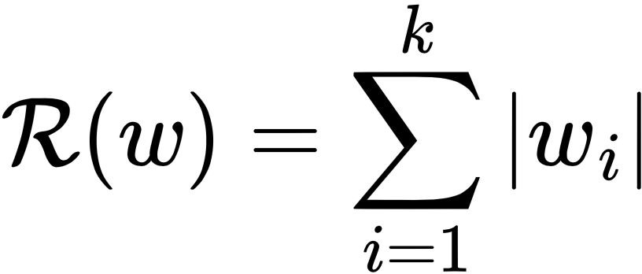
L1 Regularization
❏ Often results in many weights being exactly 0 (while L2 just makes them small but nonzero)
❏ You may want to combine L2 and L1?

Slide 23
Questions
What if a fixed percentage of employees is selected every morning to have a paid time-off that day? Will the company as a whole be more productive?
What if for every assignment or homework, a small percentage of the students are waived to turn in their work. Will the students learn more materials as a whole?
Answers are probably a NO. But an analogy in Deep Learning turns out to be helpful more often than not

Slide 24
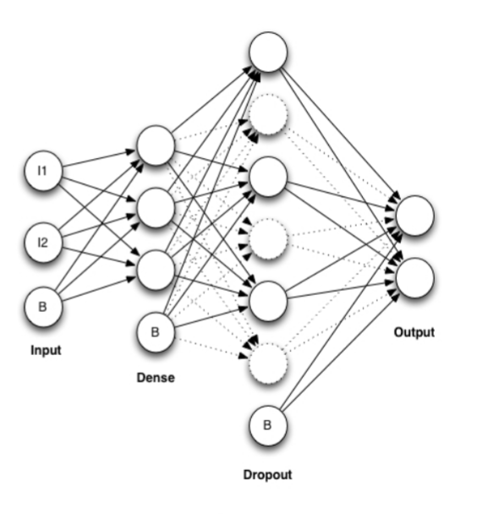
Dropout
A Dropout layer is a dense layer that temporarily eliminate some of its neurons.
The discarded neurons are not permanently removed but being temporarily disabled. They are represented by the dash line.
Each dropped neuron connection will not be trained so its weights will not be based on trying to best fitted the training dataset. The final neural network will use ALL of these neurons for the output
The goal of having a dropout layer is to decrease the chance of overfitting

Slide 25
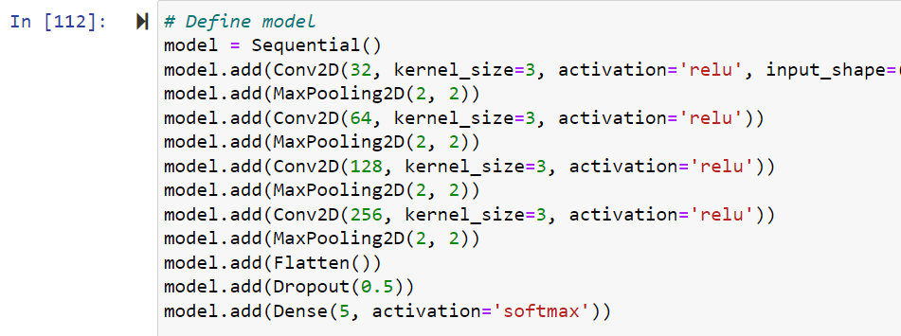
Dropout in action

Slide 26
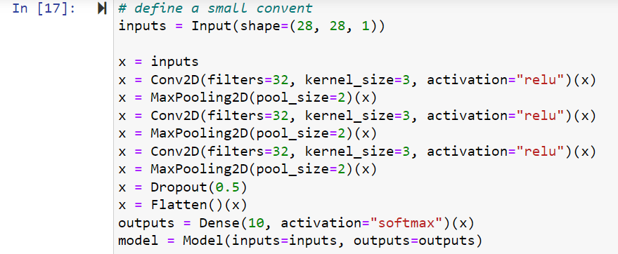

Dropout in action

Slide 27
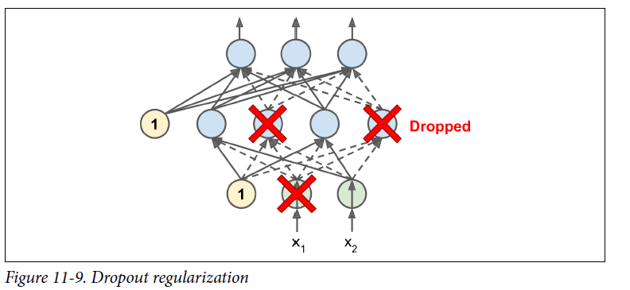
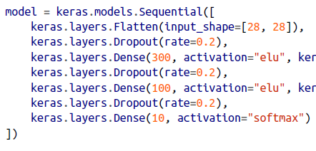
Dropout
Use it in Keras simply require adding a Dropout layer with a drop out rate which is usually set between 0.2 to 0.5
Example:
https://machinelearningmastery.com/dropout-regularization-deep-learning-models-keras/

Slide 28
Another common challenge
Deep Neural Network has too many model parameters, but not enough data to train the network
In classical linear regression, if you have 100 features with 100 training data, you can completely solve the equations
Solutions: (1) Data Augmentation (2) Transfer Learning

Slide 29
Data Augmentation
Not enough sample data collected for the phenomenon e.g. earthquake
Data augmentation artificially increases the size of the training set by generating many realistic variants of each training instance.
This can reduce overfitting, making this a regularization technique.
Danger is introducing bias not present in the population

Slide 30
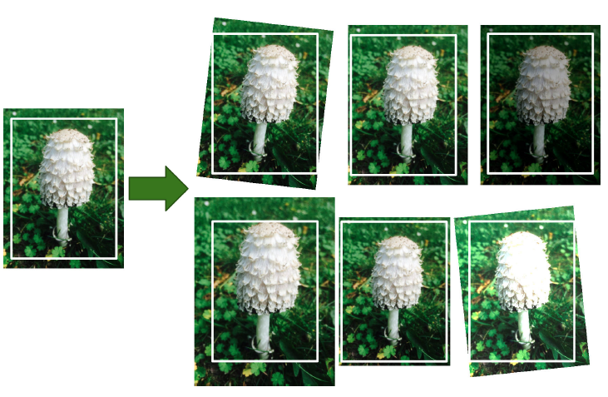
Data Augmentation example
Generate new images by slightly shift, rotate, flipping and resize every picture in the training set by various amounts.
This forces the model to be more tolerant to variations in the position, orientation, and size of the objects in the pictures.

Slide 31
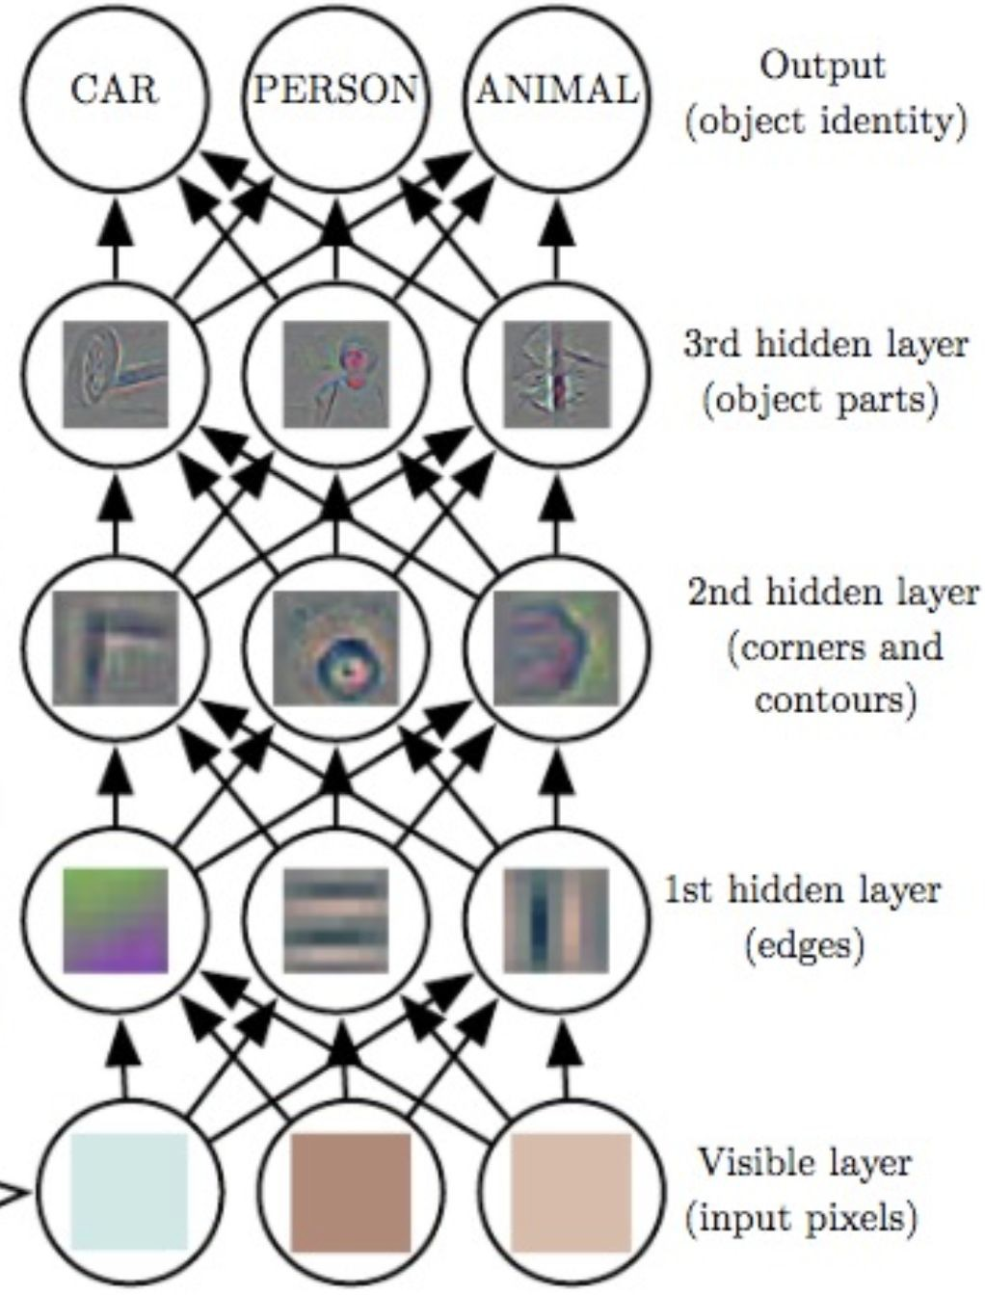

Transfer learning in computer vision
A representation of the data extracted inside a network (rather than the input or predicted output)

Slide 32
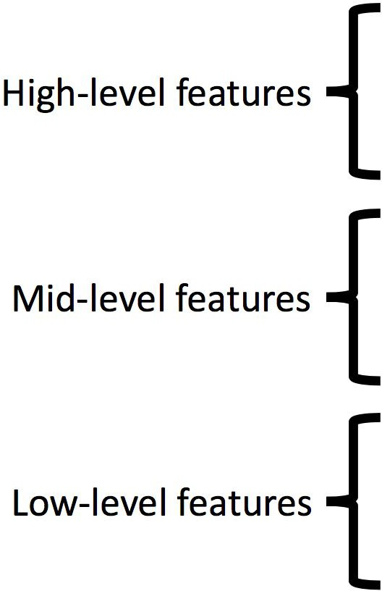
Transfer learning in computer vision
Pretrained features

Slide 33
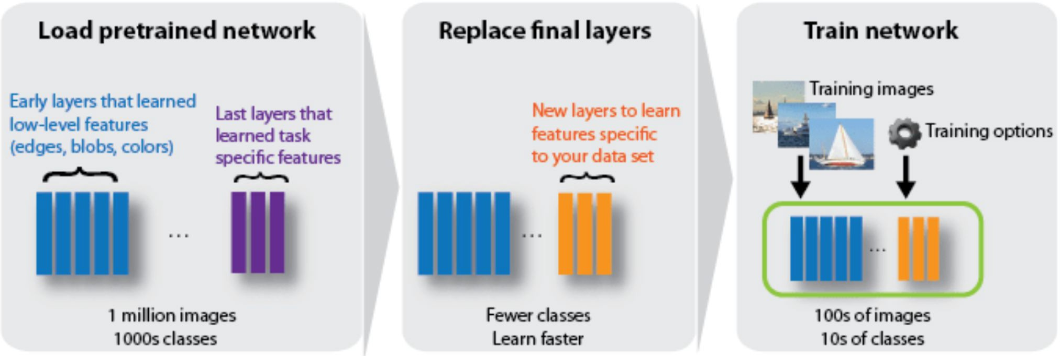
Transfer learning in computer vision
Fine-tune (aka transfer learning)
Image Source: https://www.mathworks.com/help/deeplearning/ug/transfer-learning-using-alexnet.html
28

Slide 34
Transfer learning in computer vision
Use a pre-trained network; freeze previous layers
Change only the last few layers
Referred as a fine-tuning a pre-trained model
29

Slide 35
Some online resources
https://towardsdatascience.com/regularized-linear-regression-models-57bbdce90a8c
https://towardsdatascience.com/regularized-linear-regression-models-44572e79a1b5
https://towardsdatascience.com/regularized-linear-regression-models-dcf5aa662ab9
https://towardsdatascience.com/regularization-in-machine-learning-76441ddcf99a#:~:text=This%20is%20a%20form%20of,linear%20regression%20looks%20like%20this.
https://machinelearningmastery.com/learning-curves-for-diagnosing-machine-learning-model-performance/

